Slide 1
COVID – 19 Opening Protocol
Guidelines are ever changing. We will do our best to continue to monitor conditions and guidelines.
Information subject to change.
COVID-19 Warning
An inherent risk of exposure to COVID-19 exists in any public place where people are present. COVID-19 is an extremely contagious disease that can lead to severe illness and death. According to the Centers for Disease Control and Prevention, senior citizens and people with underlying conditions are especially vulnerable. By visiting/training with American Spirit Athletics you voluntarily assume all risks related to exposure to COVID-19
All information subject to change per CDC updated guidance updated Aug 16, 2021

Slide 2
What is COVID-19?
Coronavirus disease 2019 (COVID-19) is an illness caused by a novel (New) virus that spreads from person to person
Coronaviruses are a large family of viruses that are common in people and many different species of animals.
Coronaviruses usually cause mild to moderate upper-respiratory tract illnesses, like the common cold

Slide 3
How is COVID 19 transmitted and spread?
COVID-19 is thought to be primarily spread through person to person including:
Between people who are within 6 feet (or 2 arms length) of each other
Through respiratory droplets produced when an infected person coughs, sneezes or talks.
Touching a surface that has the virus droplets on it and then touching your mouth, nose, or eyes.
The virus can be spread by people not showing symptoms
Notes:
From:
https://www.cdc.gov/coronavirus/2019-ncov/prevent-getting-sick/how-covid-spreads.html?CDC_AA_refVal=https%3A%2F%2Fwww.cdc.gov%2Fcoronavirus%2F2019-ncov%2Fprepare%2Ftransmission.html

Slide 4
Most COVID-19 transmission occurs through Close Contact
Close contact is
10 to 30 minutes within 6’ of the individual 2 days before symptoms start or have a positive test.
Had direct personal contact with someone like shared a hug, kiss or handshake
Were coughed or sneezed on, had contact with dirty Kleenex, shared food or shared personal items like a towel or glass
People who live in the same house
Sleeping overnight in the same home

Slide 5
How long can COVID-19 remain viable?
Information subject to change as CDC updates
Airborne
The virus can remain in the air for 3 to 4 hours, but most particulates fall much more quickly.
Surfaces
The length of time the virus can remain on surfaces varies
Copper – up to 4 hours
Plastic and Stainless Steel – 2 to 3 days
Cardboard – up to 24 hours
Notes:
https://www.health.harvard.edu/diseases-and-conditions/covid-19-basics#:~:text=A%20recent%20study%20found%20that,plastic%20and%20stainless%20steel.
In the air - New England Journal of Medicine on March 17, 2020.

Slide 6
What are signs and symptoms of COVID 19?
COVID-19 affects different people in different ways. Infected people have had a wide range of symptoms reported – from mild symptoms to severe illness. Symptoms that may appear 2-14 days after exposure to the virus are:
THE BIG 3:
Cough
Shortness of breath or
Difficulty breathing
Fever
AND/OR 2 + OF THESE:
Chills with or without shaking
Muscle pain
Headache
Sore throat
New loss of taste or smell
Nausea/Diarrhea
Notes:
The big 3 – stay home! 2 or more of the other symptoms you should contact a medical professional

Slide 7
What do I do if: I have SIGNS or SYMPTOMS of COVID-19? I have a SUSPECTED or CONFIRMED DIAGNOSIS of COVID-19? Someone in my household or I’ve been on close contact with has a CONFIRMED DIAGNOSIS of COVID-19?
Stay HOME! Submit student absence
Notify ASA
Get Tested!
CA testing info: https://covid19.ca.gov/testing-and-treatment/
Before you go for testing, contact your Medical Provider or a Testing Site
To find a Testing Site:
Call COVID-19 hotline at 833-422-4255
Visit: https://covid19.ca.gov/
If Staff, Call your On-Call Supervisor & follow the steps on Finding a Sub provided by the Supervisor
Notes:
Close contact means:
15 or more minutes within 6’ of the individual 2 days before symptoms started or positive test.
Had direct personal contact – hug, kiss or handshake
Coughed or sneezed on, had contact with their dirty Kleenex, shared personal items like a towel, glass or food

Slide 8
Stay Home? For How Long?
You have SIGNS or SYMPTOMS COVID-19?
Stay home in Self Isolation until:
Contact Medical Provider/Testing Center
Symptoms have improved
At least 10-14 days since your first symptoms appeared or test date
No Fever for 72 hours without medication
A negative test result can allow you to return to work/sports/arts as soon as you are better

Slide 9
Stay Home? For How Long?
You have a SUSPECTED or CONFIRMED DIAGNOSIS of COVID-19?
Stay home in Self Isolation until:
No Fever for 72 hours without medication
Symptoms have improved
At least 10-14 days since your first symptoms appeared OR positive test result OR negative test results (typically 2 tests 24 hours apart after a positive test)
CONFIRMED CASE:
Participants are required to have a note from a DO/MD/PA/NP to return

Slide 10
Stay Home? For How Long?
You have someone in your household or have had close contact with has a CONFIRMED DIAGNOSIS of COVID-19
Stay home in Self Isolation until:
If unable to isolate from the COVID+ individual: 14 days after the ill person is released from isolation
If able to isolate from the COVID+ individual
14 Days from Exposure
Speak with a medical professional or your local health department for advice

Slide 11
COVID-19 SAFER OPERATIONS

Slide 12
How can ASA operate safely
Participants, Staff & Spectators
Enhanced cleaning protocols
Staff & Participant Education
COVID-19 Response Team
Gym Organization & Operations
MonitorPhysical Distancing

Slide 13
Physical Distancing

Slide 14
Kids + Sport = People in Motion
Because 6 feet isn’t always 6 feet
Notes:
Distancing with kids, particularly when active, 6’ is not always enough.

Slide 15
Physical Distancing Strategies- We will continue to follow state, local, national guidance that also directs to information from the American Academy of Pediatrics (and for our specific activities)
Limiting Participants and Spectators
Mark waiting areas at Gym Entrance
Marked Athlete Positions-marked areas for storage of personal items/water
Monitor Training Stations
Removal of non-essential Equipment and Chairs
Elimination of Congestion Points
Controlled Rotations

Slide 16
Gym Organization & Operation

Slide 17
Gym Organizational Changes
Modify Traffic Patterns
Minimizing High Touch Areas
Eliminate Hard to Clean Area
Increase Hand Sanitizing Stations
Improve Access to Cleaning Supplies
Reconfigurations/Removal of Equipment, Chairs and Materials

Slide 18
Gym Operational Changes
Reopening
1: Athletes only in the gym area.
Separate Entrance & Exit
Staggered Class Times
Adjustments made to class times to allow for more physical distancing and time to clean/disinfect.
Utilize Digital Processes
Electronic Lesson Plans, Rotation Schedules, Accident Reports & Class Records
All enrollments and transactions are done online via the IClassPro app.
Handouts via Email/FB
2: Manage student to instructor ratios
3: Limit number of classes in training area.
4: Special Events/parent showcases at later date, under state guidelines

Slide 19
Gym Operations
Class Sizes
Reductions in Coach to Athlete Ratios as appropriate. All Cohort guidelines will be followed for specified training.
No Common Use Area
Athletes will bring and take care of own supplies: Mask, large water bottle.
Minimal Parent Viewing
Limit of 1 Spectator per Family in lobby for children ages 3-4 if necessary. Maintain social distancing.
No Cubbies
No Drinking Fountains, Water Bottle or Chalk Buckets available.
No Make Ups
Tuition rates are monthly.
Military discount calculates rate on a three-week month.
Remain outside in designated training/waiting areas.

Slide 20
Participants, Staff & Spectators

Slide 21
We think you are INCREDIBLE…
That is why ASA Staff will utilize Masks & Gloves Personal Protection Equipment (PPE) during assigned times and while performing specified duties at ASA & our Participants and Spectators will wear masks when entering & exiting the building and if/as required by MCAGCC/MAGTFTC, City of 29 Palms and or CA guidelines.

Slide 22
All Staff, Participants & Spectators Must
Mask
Mask mandates are ever changing. We will follow local, state and or federal guidance
Personal Belongings
Bring minimal personal belongings
Screening
EVERYONE must ensure no common symptoms present

Slide 23
Screening Procedures
Spectators
Participants
Staff
Will follow local, state, federal guidance. Any signs of illness, staff will not be permitted to instruct class. With significate traveling staff will be required to show proof of vaccination or negative COVID-19 test.
Parents/guardians must review and accept online information waiver.
Will follow local, state, federal guidance. Any signs of illness, students will not be permitted to participate in class.
If a participant is denied entry or sent home due to suspected COVID, a medical release is required before they can return to the gym

Slide 24
Participant Changes
Rotating Coaches
Prepare Coaches & Participants for Coaching Changes
Exercise
Minimal to No Spotting
“Rescue Spotting” Only
Rotate one at a time & report to assigned area
Minimal Circuit Work
Remain on one apparatus (like the same beam) & athletes may not get to use every item/station
Advanced permission for all other spotting

Slide 25
Participant Changes
Less Equipment Available
Equipment stays at station/area
No Hanging Out
Equipment
Escort to Door
No Group Snack-subject to change
Athlete Belongings
Bring & take home own supplies
Personal items kept with or placed in designated areas & only touched by with athlete
No lost and found – items left will be disposed of
No Shared Treats
Any Equipment use will be cleaned regularly and after each class

Slide 26
All Staff
Cross Training across All Departments
Break Room Closed
Assigned cleaning tasks between classes/groups
No staff on site when not working
Bring personal bag to put ALL personal items in while working
Suggestion to limit the number of personal items you bring to the gym

Slide 27
Protocol for Coaching Staff
Enhanced Attendance Monitoring with follow up with absent athletes
Frequent hand washing before and after classes
Strict Adherence to Rotation Schedules
No hugs, high fives, fist bumps or “contact” celebrations. We are mindful of contact.
Arrive dressed for work, when possible
Coaches may carry their own first aid/sanitation caddy/Have access to all supplies

Slide 28
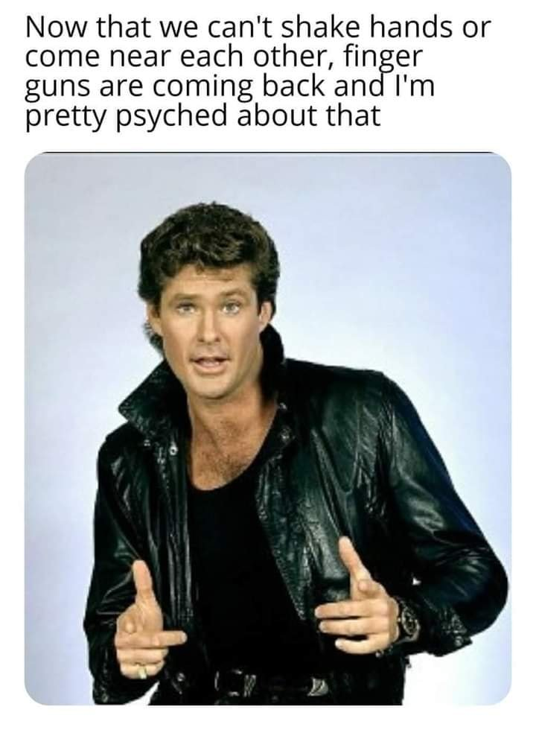
We still need to keep things fun!

Slide 29
Enhanced Cleaning Protocols

Slide 30
Cleaning Processes Modifications
More frequent cleaning
Additional Cleaning Products
Beginning & End of Day
After Group Use
High Touch Areas
After Individual use
Using Healthier Options of CDC Recommended COVID-19 Disinfectants
Gymnastics flooring cleaning with MCCS UV light machine
Increased Building Ventilation
Opening of doors at regular intervals throughout building

Slide 31
Staff & Participant Education

Slide 32
Our Staff & Participant Education is designed to
Meet Governmental Requirements
Meet MCAGCC/MAGTFTC, City of 29 Palms Requirements
Make sure everyone can answer these questions:
What do I need to know to be safe?
What precautions can I take to protect myself and others?

Slide 33
Education and Training Via Gym Signage, Zoom & Google
Topics Include:
Gym Policies
COVID 19 Awareness & Prevention
Hygiene Practices
Reminder Signage throughout gym/classroom
Confirmation of Participation
Complete Electronic Assessments on Key Topics

Slide 34
Required COVID-19 Training
Physical Distancing Practices
Staff Must Know:
Everyone Must Know:
What is COVID-19
Good Hygiene Practices
Screening Procedures
Proper Use of all PPE
Proper Cleaning & Disinfecting
How to handle a suspected or confirmed COVID-19 individual in the gym

Slide 35
COVID-19 Response Team

Slide 36
RCG COVID-19 Response Owners
Sanitation Controls
Ashley Olson/Keila Haynes
Ensure environment is cleaned and disinfected
Health Surveillance & Record Keeping
Keila Haynes, Lisa Hemmie
Ensure screening protocol is implemented
Manage screening records
Training, Tracking and Communication
Ashley Olson
Ensure & Track Staff Training
Monitor Staff & Athlete Schedules and Rotations
COVID Response Leader
Lisa Hemmie
Staff/Member/Media Communication
Monitor State & Local Public Health Communications about COVID-19
Establish Hygiene Practices & Isolation protocols
Ensure adequate Signage
Health Department Communication
Positive Case Protocol
Manage supplies and monitor proper usage
Monitor Staff Attendance
Monitor Participant Attendance
Identify & Monitor Risks for Exposure Determination
Engineering Controls
Lisa Hemmie working with MCCS/City as necessary
Ensuring existing equipment is modified for minimizing transmission
Order and install proper protective equipment
Ensure & Track Participant Training
Administrative Controls
Ensure PPE is available and properly used

Slide 37
Key COVID-19 Training Concepts

Slide 38
How to Physical Distance

Slide 39
Physical Distancing Practices
Put 6’ of distance between yourself and other people outside of your home.
This includes limiting proximity to friends, athletes, parents & other staff, especially in enclosed areas
Whenever this is not possible, wear a mask
Avoid close contact with people who are sick.
If possible, maintain 6 feet between the person who is sick and other household members.
Remember that some people without symptoms may be able to spread virus.

Slide 40
Practicing Good Hygiene

Slide 41
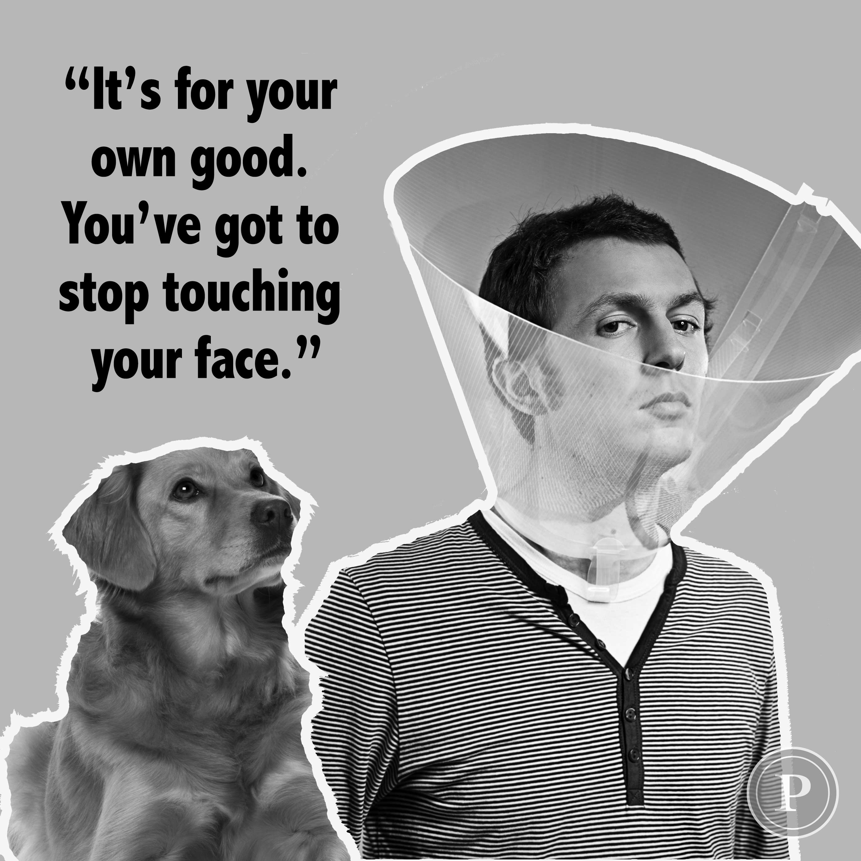

Slide 42
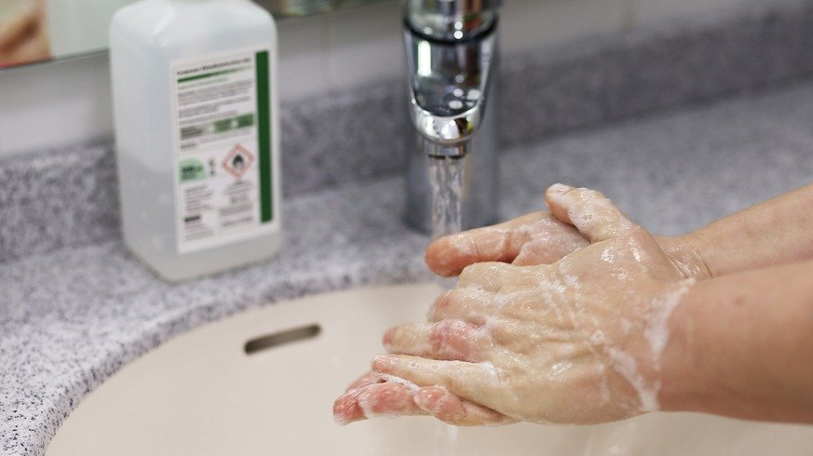
In general, you should wash your hands
After you have been in a public place
After being close to someone who has coughed or sneezed
Before touching your eyes, nose, and mouth
After touching things others have touched
Notes:
Why you wash your hands…kills virus on your hands & what you come in contact with

Slide 43
When should I wash my hands at the gym??
Wash in, wash out (entering and leaving the building)
Before and after removing a mask
Before and after contact with another person
After removing gloves
After contact with high touch area
After using the bathroom
Before and after eating
Visibly dirty
WHEN IN DOUBT, WASH YOUR HANDS

Slide 44
COVER YOUR COUGH AND SNEEZE
Cover
If you are not wearing a cloth face covering, cover your mouth and nose with a tissue or your elbow when you cough or sneeze.
Throw
Throw used tissues in the trash.
Wash
Immediately wash your hands with soap and water for at least 20 seconds.
If soap and water aren’t available, clean your hands with a hand sanitizer that contains at least 60% alcohol.

Slide 45
HANDWASHING 101

Slide 46
How to wash your hands-video
How to wash your hands video link: https://youtu.be/IisgnbMfKvI
Notes:
How to wash your hands video link: https://youtu.be/IisgnbMfKvI

Slide 47
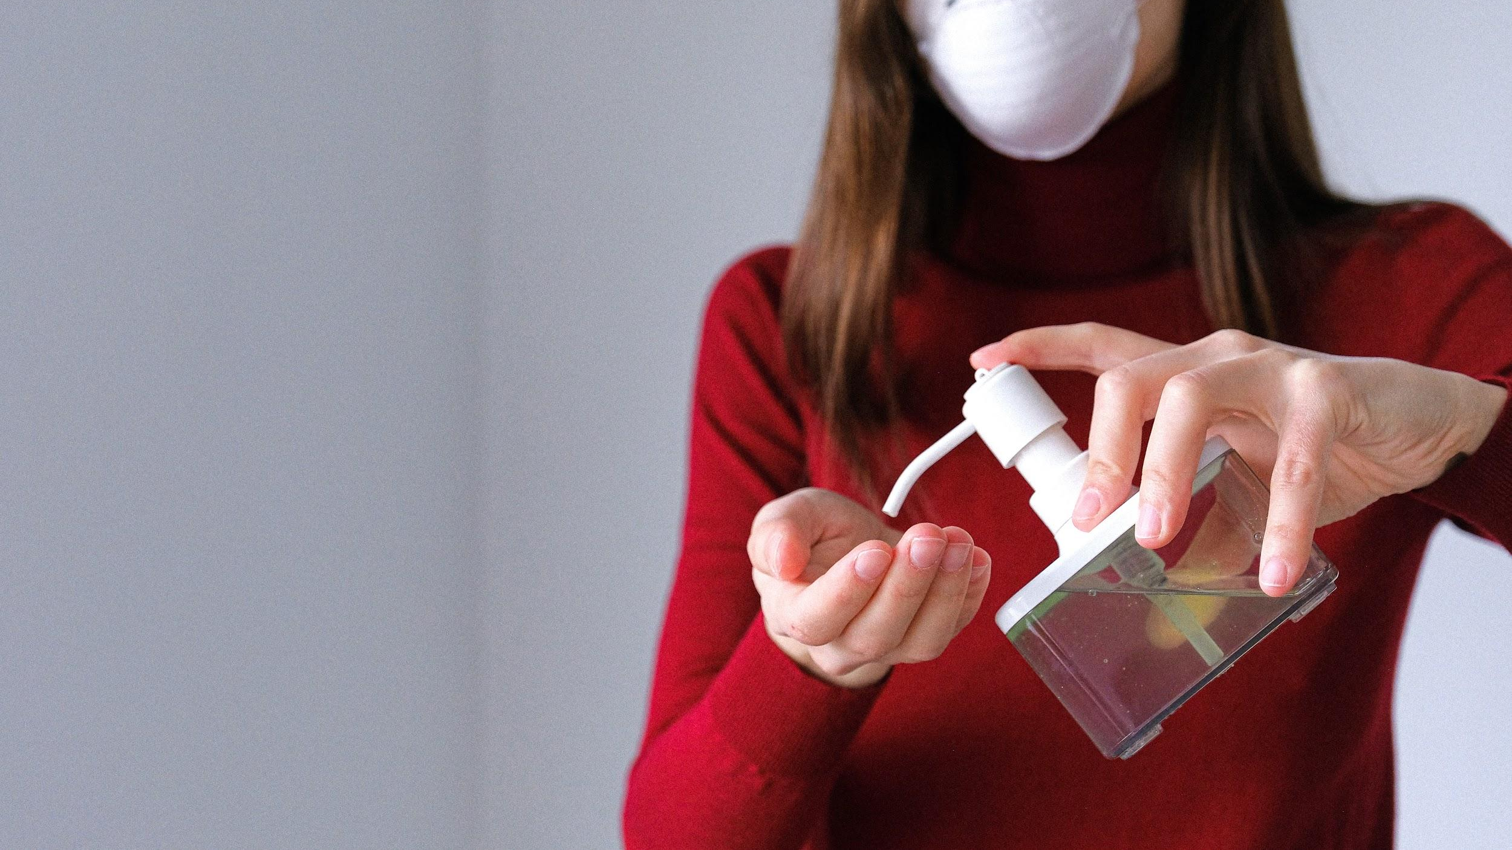
What about hand sanitizer?
If soap and water is not readily available, you can use an alcohol-based hand sanitizer that is 60% alcohol.
If your hands are visibly dirty, you should wash before using hand sanitizer.
It is ALWAYS best to wash with soap and water

Slide 48
How to use Hand Sanitizer-video How to use Hand Sanitizer video link: https://youtu.be/4xC-_7ZiQoY
Notes:
How to use Hand Sanitizer video link: https://youtu.be/4xC-_7ZiQoY

Slide 49
Participant & Staff Screening Protocols

Slide 50
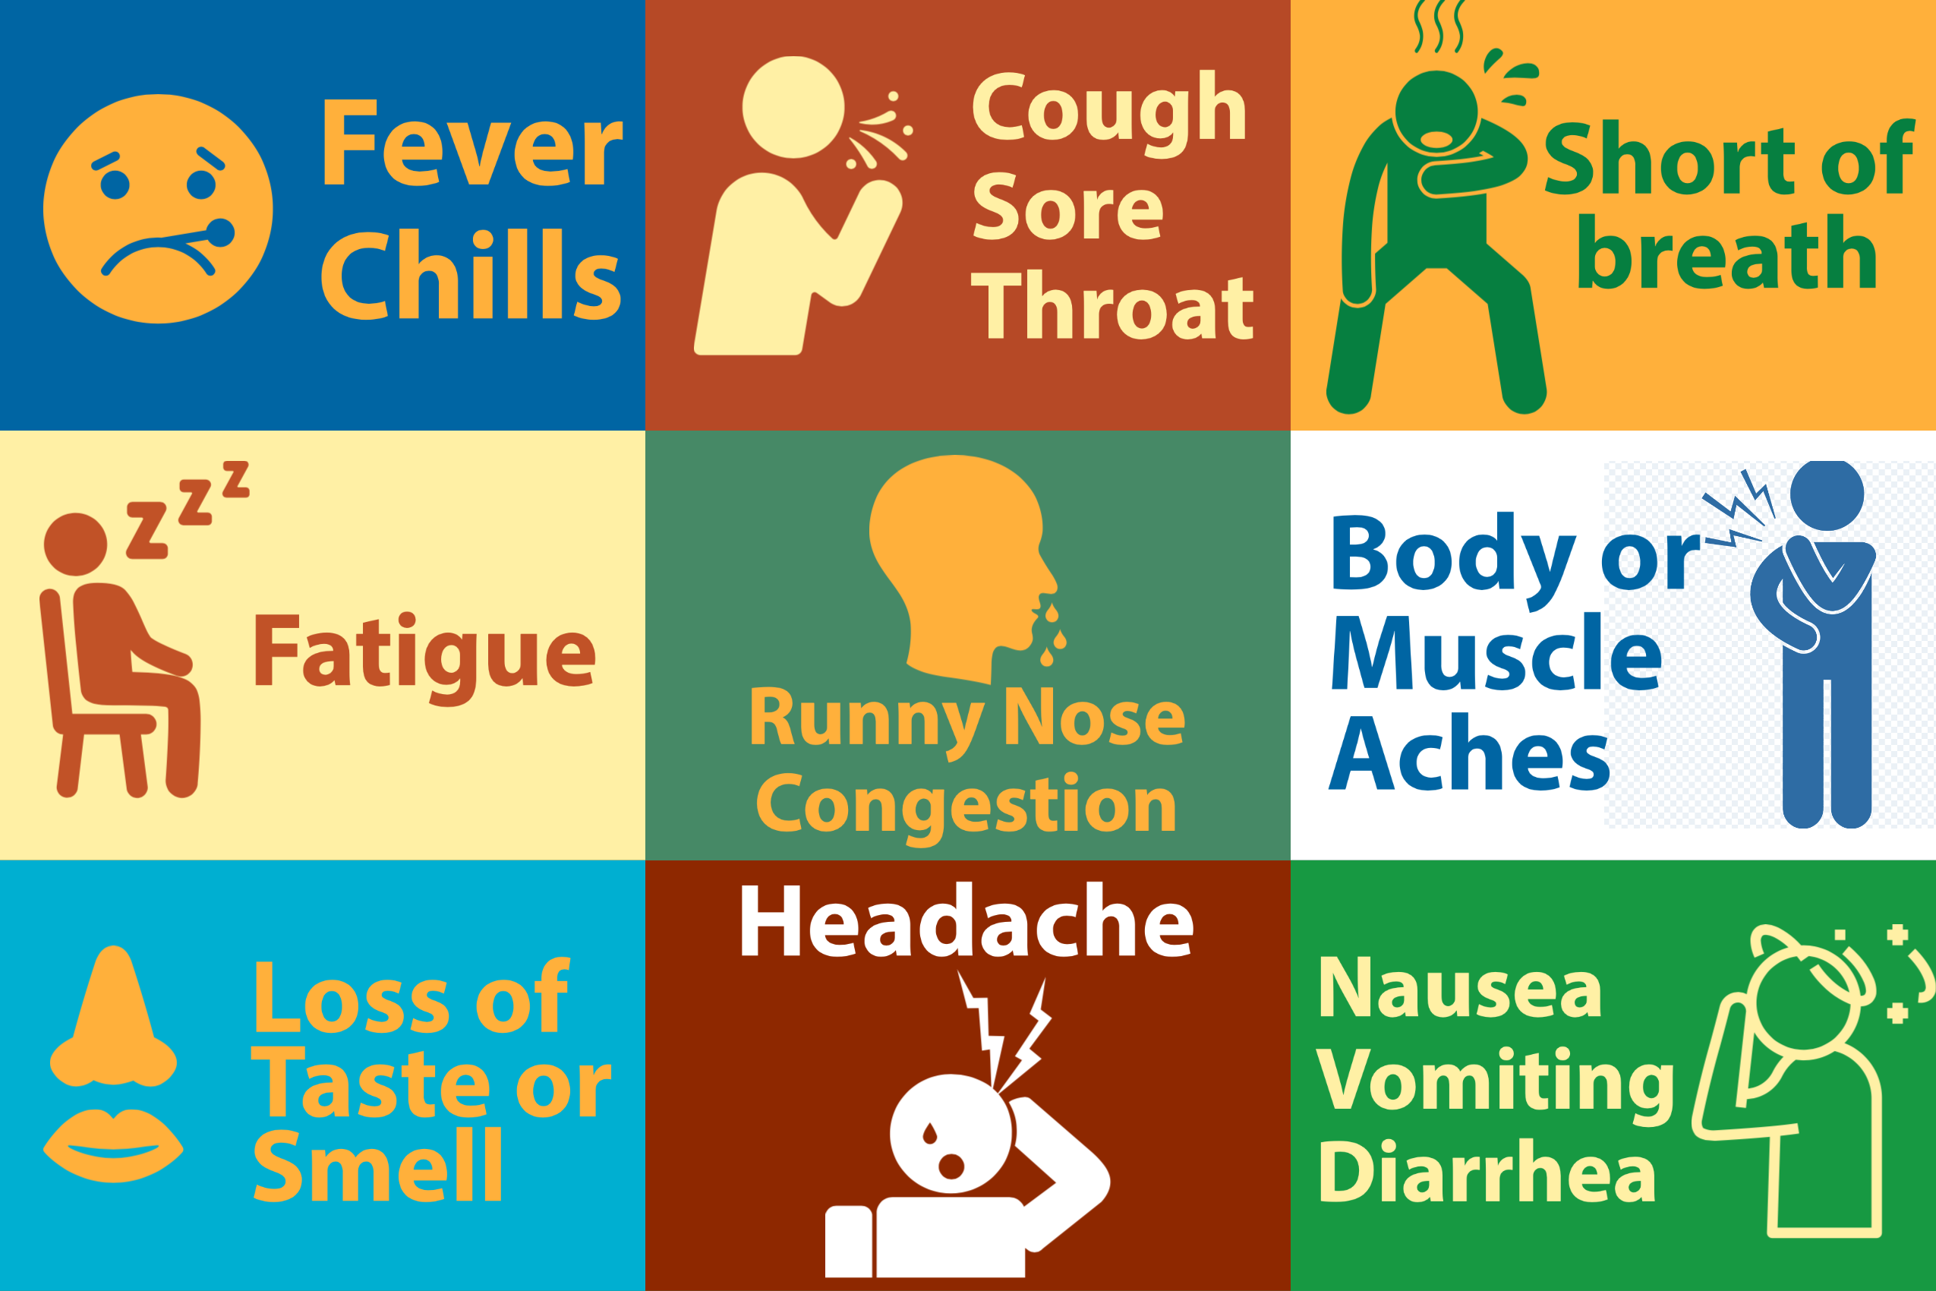
Health Screening Questions
Do you have any of the symptoms of COVID-19 not related to another illness?
In the last 14 days have you (Participant) been in close contact with someone who has tested positive for COVID-19?

Slide 51
Staff Self- Screening
Perform before shift
ASA Electronic Form Self Assessment
May also view CDC Self Check
https://www.cdc.gov/coronavirus/2019-ncov/symptoms-testing/testing.html

Slide 52
Participant Self- Screening
Daily Self Assessment via CDC
https://www.cdc.gov/coronavirus/2019-ncov/symptoms-testing/coronavirus-self-checker.html

Slide 53
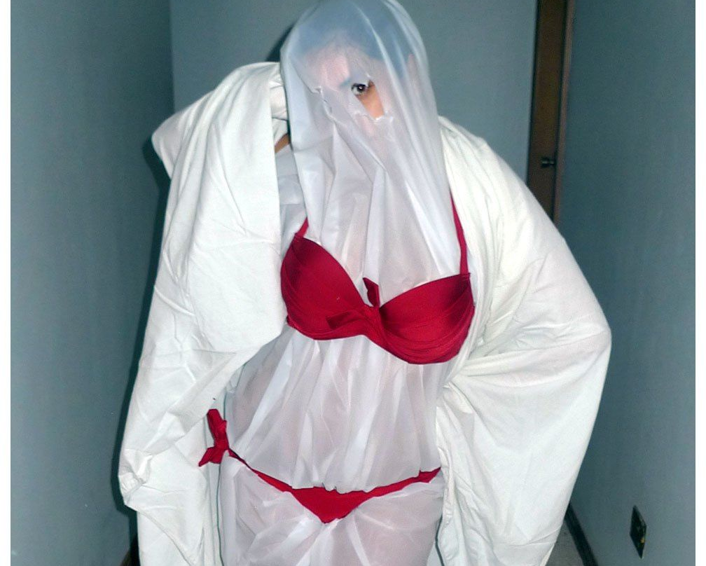
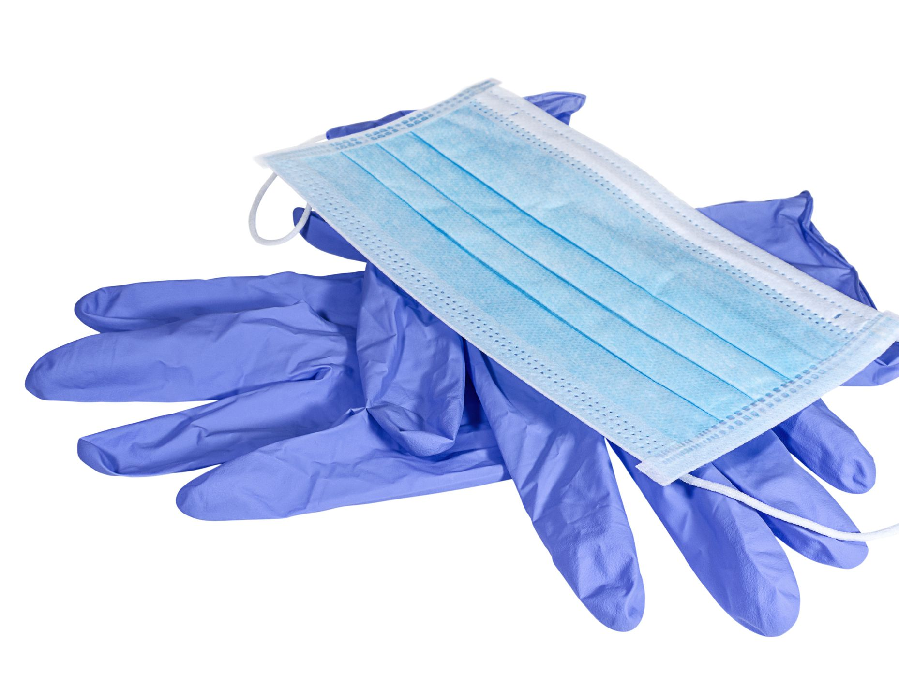
What kind of PPE do Screening Staff require? Staff will wear masks. Gloves as necessary

Slide 54
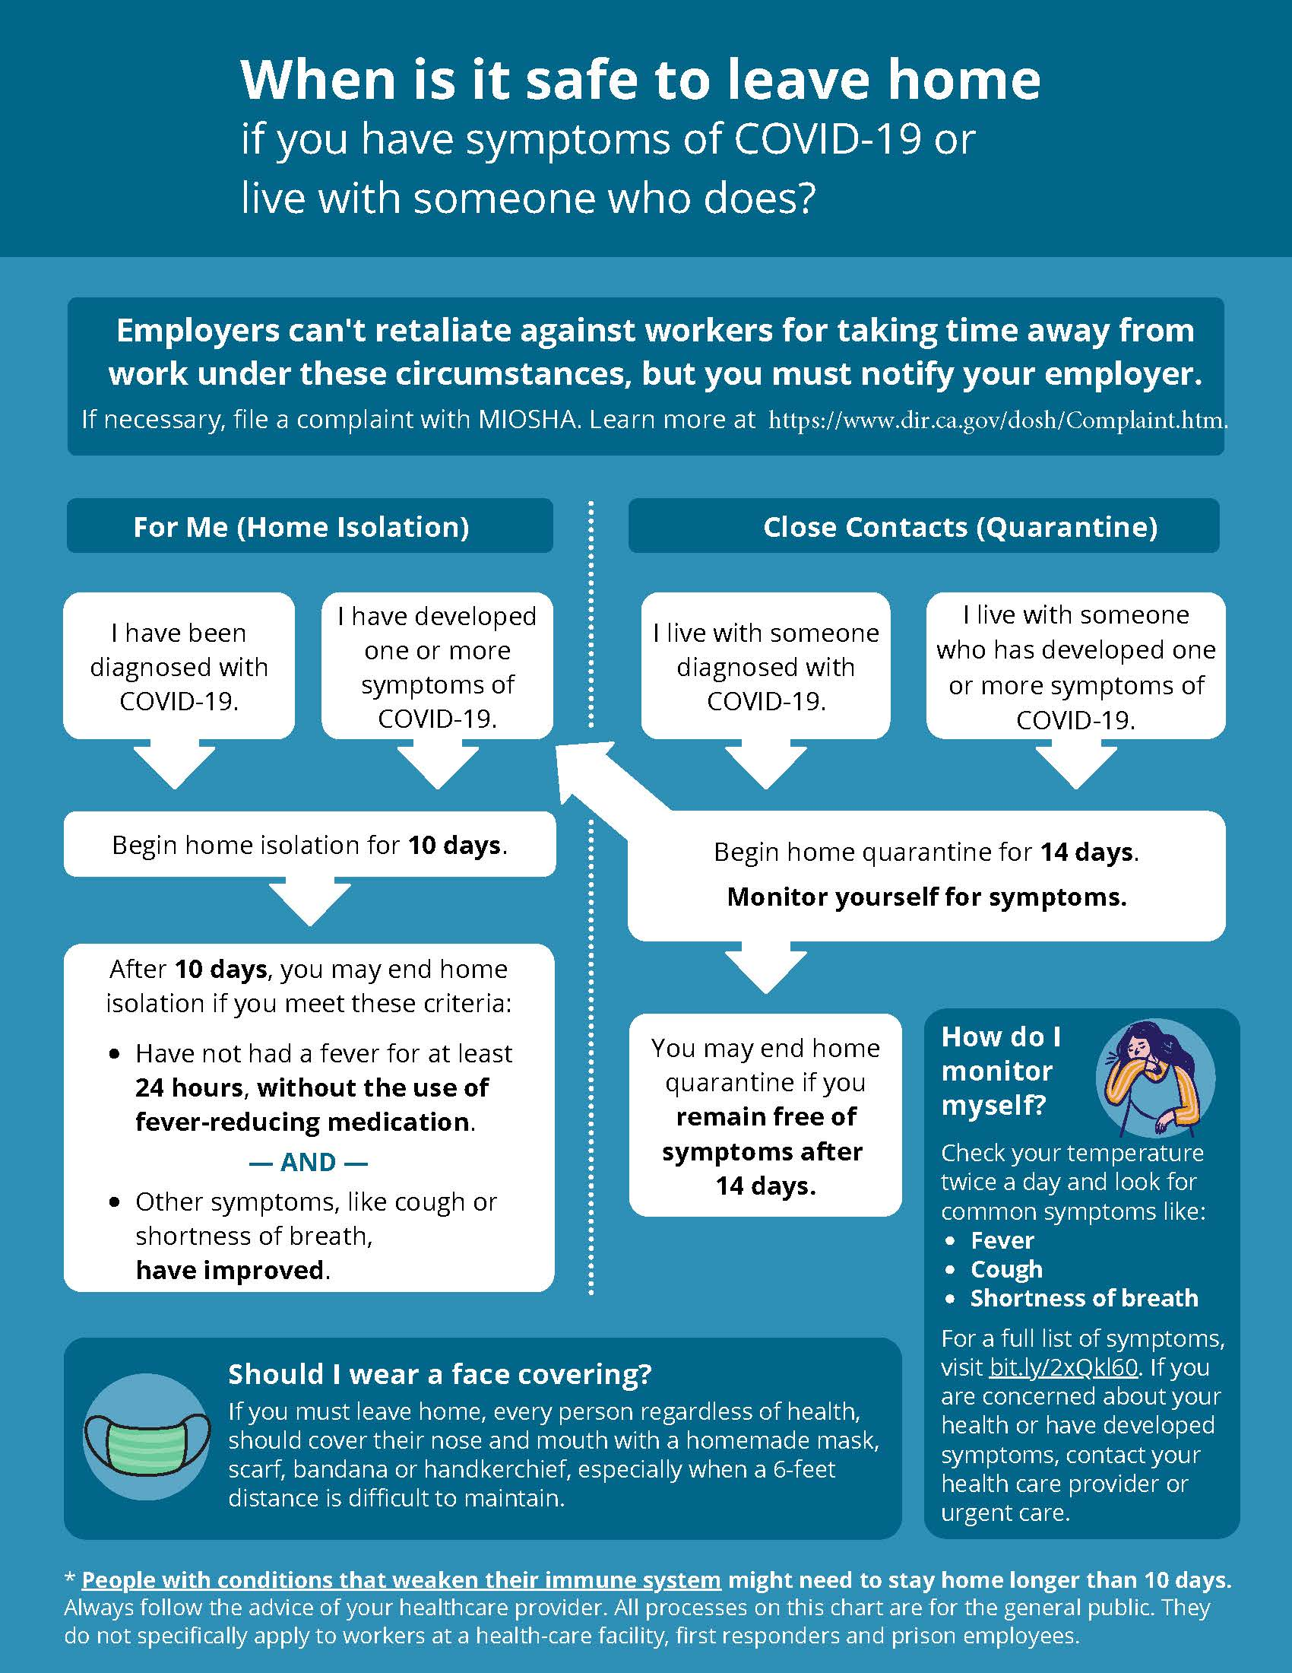
When to Leave Home Guidelines
*Expanded COVID testing access can change quarantine requirements. Please check with your local health department and/or a medical professional for advice on interpretation of testing results and quarantine requirements

Slide 55
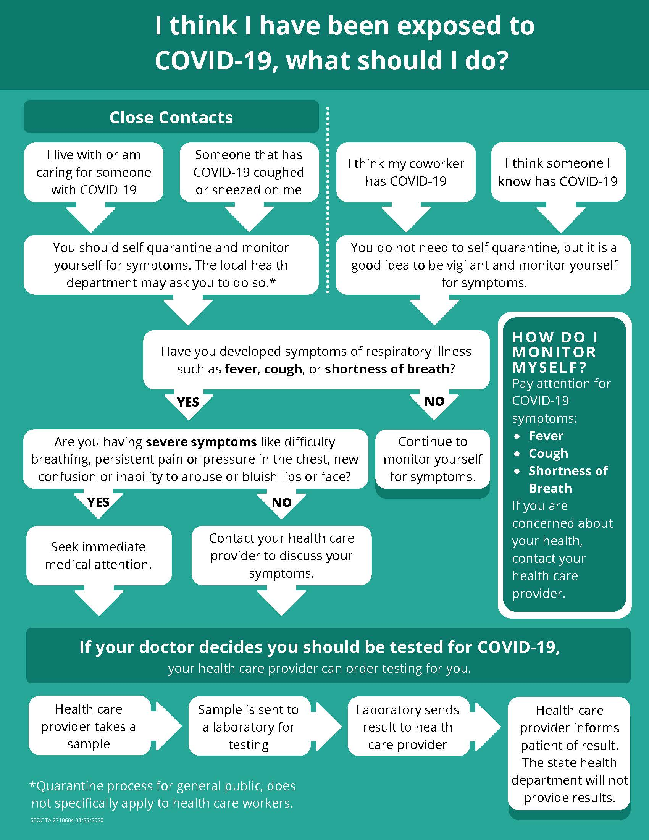
Potential Exposure Guidelines
*Expanded COVID testing access can change quarantine requirements. Please check with your local health department and/or a medical professional for advice on interpretation of testing results and quarantine requirements

Slide 56
All About PPE

Slide 57
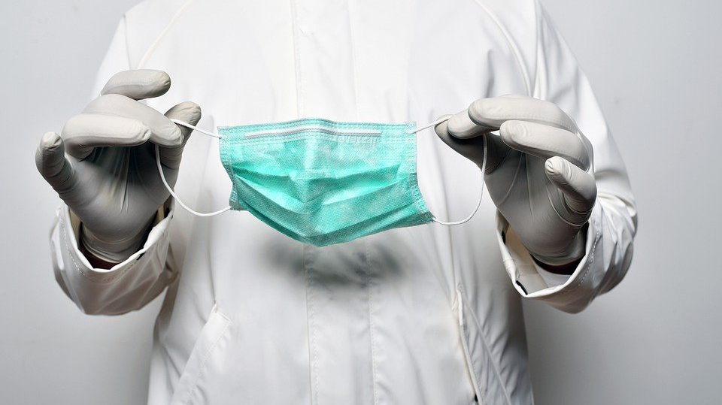
When to wear a mask
Arrival and Departing the location-any guidelines as set forth by MCAGCC/MAGFTC/City
Participants and staff as they enter the gym
When you will intentionally be within 3-6’ of someone
When you are providing first aid
When you are spotting
When you are within a closed room/small space with someone
When you are around someone who has COVID-19 symptoms
When cleaning/disinfecting the gym

Slide 58
How to remove a mask
Always clean your hands with soap and water or hand sanitizer before touching & after removing your mask.
The front of the mask is contaminated. Only touch the ear loops/ties/band.
Follow the removal instructions below below for the type of mask you are using.
Face Mask with Ear loops:
Hold both ear loops and gently lift to remove
Face Mask with Ties:
Untie the bottom bow first.
Untie the top bow next pulling the mask away from you as the ties loosen
Face Mask with Bands:
First lift the bottom strap over your head.
Next pull the top strap over your head.

Slide 59
Handling Your Masks
Disposable
If soiled, throw mask into trash
If reusable, place in a paper bag in a safe place to allow to dry
Cloth
If soiled, place in plastic bag until it can be handwashed with soap & water or laundered.
If reusable, place in a paper bag in a safe place to allow to dry
To avoid contamination, do not touch your mask while wearing it
Masks can be reused if not visibly dirty or worn.

Slide 60
How to remove a mask-video
How to remove a mask video link: https://youtu.be/OABvzu9e-hw
Notes:
How to remove a mask video link: https://youtu.be/OABvzu9e-hw

Slide 61
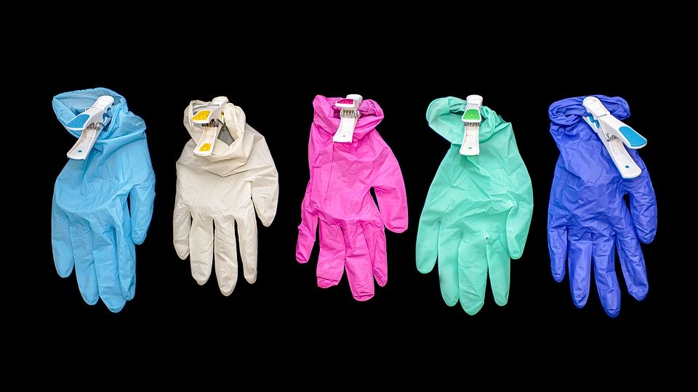
When to wear gloves
Staff as they enter the location if necessary
When you are providing first aid
When you are around someone who has COVID-19 symptoms
When cleaning/disinfecting the gym
DO NOT REUSE GLOVES

Slide 62
How to remove gloves properly-video How to remove gloves properly video link: https://youtu.be/xTYioOo__6U
Notes:
How to remove gloves properly video link: https://youtu.be/xTYioOo__6U

Slide 63
Proper Cleaning & Disinfection

Slide 64
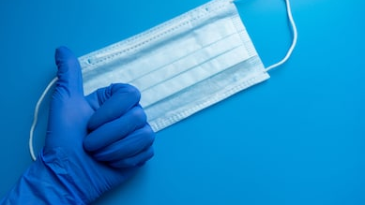
Cleaning PPE
GLOVES & MASK
EVERY TIME

Slide 65
When will things be cleaned?
2-3 Times Per Day
Between Class Block
Daily
Alternating Days / Bi-Weekly
After Use
Weekly

Slide 66
After Use
What
By Whom
Equipment Cables/Handles
Weights/Sliders
Shapes/Markers
Full Contact Mat Use
Office Equipment
Coaches
Support Staff
Administrators

Slide 67
Between Class Blocks
What
By Whom
Matting, Studio Floor
Coaches
Support Staff
Administrators

Slide 68
2-3 Times Per Day
What
By Whom
Bathrooms/MCCS
High Touch Area
Coaches
Office Staff
Support Staff
Administrators

Slide 69
Daily
What
By Whom
Flooring
High Use Gym Carpet
Chairs
Dance Room
High touch areas
Coaches
Office Staff
Support Staff
Administrators

Slide 70
Alternating Days/Bi-Weekly
What
By Whom
Flooring/Gym Carpet
Staff Common Area
Dance Room
Coaches
Office Staff
Support Staff
Administrators

Slide 71
Weekly
What
By Whom
Low/No Contact Surfaces
Pro Shop
Coaches
Office Staff
Support Staff
Administrators

Slide 72
What will we use to clean?
Area To Clean
Product to Use
Equipment / Materials Needed
Hard Surfaces
Porous Surfaces
Carpeting
Matting
Bathroom by MCCS
Flooring
Biohazard Area
Hydrogen Peroxide
Hydrochlorous Acid
Clorox Wipes
CaviCide
Window Cleaner
Isopropyl Alcohol Spray
MCCS approved sanitizer
Spray Bottle
Aerosol Can
UV light/Floor
Vacuum
Microfiber Mop
Broom
Dust Mop

Slide 73
Order of Cleaning
Rule 1
Clean from Top to Bottom
Rule 2
Clean from Dry to Wet
Rule 3
Work towards the Exit

Slide 74
Bathrooms-MCCS/City has janitorial service
Once Per Day: General Cleaning + High Touch Cleaning
Once per week:
Dust corners, tops of stalls, etc.
When done, properly dispose of PPE & wash hands
Take out all trash (as needed throughout the day)
High Touch Cleaning-We can assist as necessary
Stock & clean paper towel, soap & toilet paper dispensers
Clean sinks and counter tops. Start by wiping all hair & debris before cleaning.
SPRAY CLEANER: Spray disinfectant over handles, faucet, sink & counters until wet. Let stand for a few minutes before wiping.
DISINFECTING WIPE: Start with faucet, handles and sink before moving to countertop. All should remain visibly wet for a few minutes after wiping. Allow to air dry. If surface isn’t visibly wet & remains wet for several minutes after wiping, change cloths
Wipe door handles, light switches and stall doors, rails & handles
Wipe all exterior parts of toilet/urinal including seat and handles.
Clean Mirrors after cleaning sink or when dirty
Spot clean any marks on walls, other surfaces
Clean Toilet Bowl / Urinal & Flush
Mop floor using a clean microfiber mop pad. Put into laundry after use
Sweep Floor (throughout the day as needed).

Slide 75
Gym/Lobby/Parent Area-MCCS has janitorial service
High Touch Cleaning: we can assist as necessary
Clean Hand Sanitizers & Vending Machines
SPRAY CLEANER: Spray disinfectant. Wait a few minutes & wipe dry
DISINFECTING WIPE: Wipe from lowest use to highest. All should remain visibly wet for a few minutes after wiping. Allow to air dry. If surface isn’t visibly wet & remains wet for several minutes after wiping, change cloths
Wipe door handles, light switches, doors, windows, stanchions & handles
Once Per Day: General Cleaning + High Touch Cleaning
Take out all trash (as needed throughout the day)
Mop floor using a clean microfiber mop pad. Put into laundry after use
Once per week:
Dust corners, baseboards, etc.
When done, properly dispose of PPE & wash hands
Sweep Floors
Wipe Signage
Spot clean any marks on walls, other surfaces
Clean Chairs in Parent Area

Slide 76
Break Room/Offices/MCCS/City/ASA etc.
High Touch Cleaning
Wipe all high use devices & appliances
DISINFECTING WIPE: Wipe from lowest use to highest. All should remain visibly wet for a few minutes after wiping. Allow to air dry. If surface isn’t visibly wet & remains wet for several minutes after wiping, change cloths
Wipe door handles, light switches, doors, windows, rails & handles
Once per day: General Cleaning + High Touch Cleaning
Take out all trash (as needed)
Mop floor using a clean microfiber mop pad. Put into laundry after use
Once per week:
Dust corners, baseboards, etc.
When done, properly dispose of PPE & wash hands
Clean Counter Tops & Tabletops & Protective Shields.
Clean Hard Chairs
Sweep/Vacuum Floor
SPRAY CLEANER: Spray disinfectant. Let stand for a few minutes before wiping.
Wipe Counter Front
Wipe all devices & appliances

Slide 77
Mats/Shapes/Weights/Flooring
After Every High Use:
Clean off any debris
Disinfect Mat/Shape
DISINFECTING WIPE: Wipe object, All should remain visibly wet for a few minutes after wiping. Allow to air dry. If surface isn’t visibly wet & remains wet for several minutes after wiping, change cloths
Between Groups - Landing Mats:
When done, properly dispose of PPE & wash hands
Spray Disinfecting Spray
Let Dry
SPRAY CLEANER: Spray disinfectant. Let dry
Carpet Bonded Foam
Disinfect Spray Daily/UV light disinfectant
Dust & Clean surface, if feasible
Vacuum as scheduled

Slide 78
Cleaning Reminders
Wear proper PPE
Avoid Cleaning with Others Around You
Change Cleaning Cloths Frequently
Log Cleaning Activity
Follow cleaning product Directions

Slide 79
COVID-19 + ACTION PLAN

Slide 80
How do we find out?
Self Reported Symptoms or Test Result
Individual with Symptoms Onsite
Call from Health Department

Slide 81
Action Steps
Identify
Communicate
Organize
Restart
Act

Slide 82
Identify
Determine
Determine the individual’s place in the gym – Staff, Student, & Class Level, Spectator
Establish
Establish timeline for when they were in the gym from 2 days prior to symptoms starting (or 2 days prior to positive test) until the individual was last in the gym.
Categorize
Potential Close Contacts
Staff & Athletes who were within 6’ of the individual for 15 or more minutes during the timeline
Any impacted Staff Members are to home quarantine
Follow HIPPA Law Requirements
Any impacted Participants cannot return to gym until quarantine is complete

Slide 83
Act
Individual should leave building immediately
If a COVID + Individual has not been in the gym in more than 24 hours
If unable, isolate them in Staff/Area/ Room until able to depart
Remove & close off any areas the individual was in that day from others in the gym
Provide mask, if they do not have one, & encourage them to wear it
Initiate Closing Procedures
Continue normal operations
If Individual is currently in the building
If a COVID + Individual has been in the gym within the past 24 hours OR
There are 3 or more COVID + Individuals within a 4-day period
Initiate Closing Procedures
Notes:
NO PIG PEN

Slide 84
Act
COVID+ Closing Procedures
Open all exterior doors in the area the individual was present for several minutes to ventilate building, if feasible.
Announce Gym Closing to Staff
Contact impacted activities to announce closing
Key Staff remains on site until building is clear
Announce Gym Closing for Disinfection publicly
Contact parents of participants within the building to arrange to pick up
Enhanced Cleaning Procedures begin 24 hours after COVID+ individual was last in the building

Slide 85
Organize
Collect all Contact Tracing Information Electronically
Gym Cleaning Team
Changes Needed for Safer Work & Practice Flow
Staffing Modifications

Slide 86
Communicate
Suspected or Confirmed COVID-19 Case
Outside Communication-Health Department Contacts Us
Contact all Impacted Staff & Participants
Activation of Enhanced Cleaning Protocol
Contact At Risk Individuals - If necessary, following HIPPA
General Gym Closure Announcement
Reopening Timeline - Determine & Announce
Close for 24 hrs. from Last Exposure
Disinfect Impacted Areas
Clean All Touch Points + Standard Cleaning
Self Identified -Contact Health Department
Share Required Information with Health Department
Closure will be 12-48 hrs. long- Depends on time/date of exposure

Slide 87
Re-Start
Re-Open
Implement Changes to Workflow / Practice Flow
Get Replacement Staff Up To Speed
Communicate Re-Opening Steps Taken to Staff and Participants
Check in with Ill & Quarantined Individuals

Slide 88
FAQ

Slide 89
ADDITIONAL COVID-19 PREVENTION STRATEGIES
Take care of yourself – Eat Well, Hydrate, Sleep
After work, immediately remove & wash the clothes you wore & shower
Wash your hands often, even when you are at home
Be sure to wipe down high touch surfaces frequently in your own home
Be mindful of where you go and what you touch in public
Moisturize your hands to minimize cracks & chapping

Slide 90
What do I do if…..
Someone coughs or sneezes on me?
DO NOT PANIC
Go wash your hands and face.
Monitor for signs and symptoms for 14 days
Stay in contact with individual in case he/she presents with signs and symptoms
I feel sick
Stay home! If symptoms of COVID &/or unrelated to another known illness, you should also contact a medical professional for advice/testing.
Monitor your signs and symptoms. Seek medical attention if needed.
If you have a fever, stay home until fever free without medication for 72 hours & symptoms have improved unless otherwise advised by a medical professional

Slide 91
What do I do if…..
What if I know my symptoms are something else?
Symptoms related to known health issues should be communicated to your direct supervisor
It is not necessary to miss work or quarantine for Non-COVID-19 Symptoms such as
Allergies
Migraines
Diagnosis with other Illnesses such as Strep Throat (after beginning antibiotic therapy)
Chronic Health Conditions

Slide 92
What do I do if…..
I think someone at the gym has COVID-19 Symptoms?
DO NOT PANIC
If discovered during Screening, deny them entrance
If the Supervisors agrees with your assessment
Provide them with a mask and encourage them to wear it
Wash your hands, put on a mask & gloves
If they are unable to do so, they must remain in the Isolation Area until they can leave.
If in classes/the gym already
Move them to the Isolation Area
The Supervisor will call their emergency contact if necessary
Have someone contact the Supervisor on Duty and ask them to come to you
Ask them to immediately leave then gym, if possible.

Slide 93
What do I do if…..
If just general exposure, you can continue to work but should self monitor your symptoms 2 times per day for the next 14 days.
What if we send someone home who has COVID-19 Symptoms?
If you were within “close contact” with this individual while not wearing a gloves and mask (6’ or less for 15 minutes or longer. etc.) you must go home and Self Quarantine for 14 days, until you and/or they have negative test results
The Supervisor will review Screening Logs and Rotation Schedules to identify & contact any other staff who may have been in contact to have them follow the appropriate protocols.
The Supervisor will contact the Health Department to provide the name of the individual

Slide 94
Any further questions?
Contact Lisa Hemmie
lisa@americanspiritathletics
323-203-7542
Guidelines are ever changing. We will do our best to continue to monitor conditions and guidelines.
Information subject to change. ASA cannot control or prevent COVID-19 in entirety.

